Slide 1

Data Analyst Virtual Intern2Grow Internship Program
Task 1: Sales Data Analysis

Slide 2
Problem Definition:
We have a set of data from a company, this data contains certain features, and our task is to answer the questions posed, The Questions are:
1- What was the total revenue generated by the company over the course of the year?
2- Which product had the highest revenue? How much revenue did it generate?
3- What was the average price of a product sold by the company?
4- What was the total quantity of products sold by the company?
5- Which category had the highest revenue? How much revenue did it generate?
6- What was the average revenue per sale?
7- What was the total revenue generated in each quarter of the year? (i.e. Q1, Q2, Q3, Q4)
We will use Python Programming Language to solve this Problem.

Slide 3
Problem Definition:
The dataset we will be using is a CSV file called sales_data.csv. It contains information about sales made by a fictional company over the course of a year. The columns in the dataset are as follows:
date: The date of the sale (in YYYY-MM-DD format)
product: The name of the product sold
category: The category of the product (e.g. "electronics", "clothing", etc.)
price: The price of the product (in USD)
quantity: The quantity of the product sold
revenue: The total revenue generated by the sale (i.e. price * quantity)

Slide 4
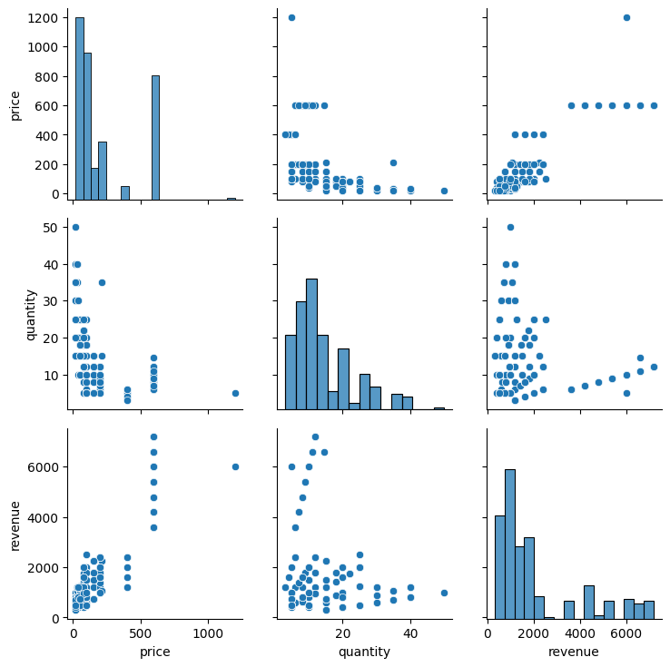
Problem Definition:

Slide 5
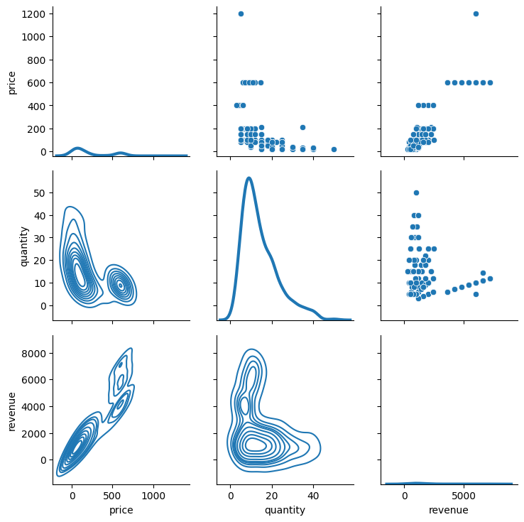
Problem Definition:

Slide 6
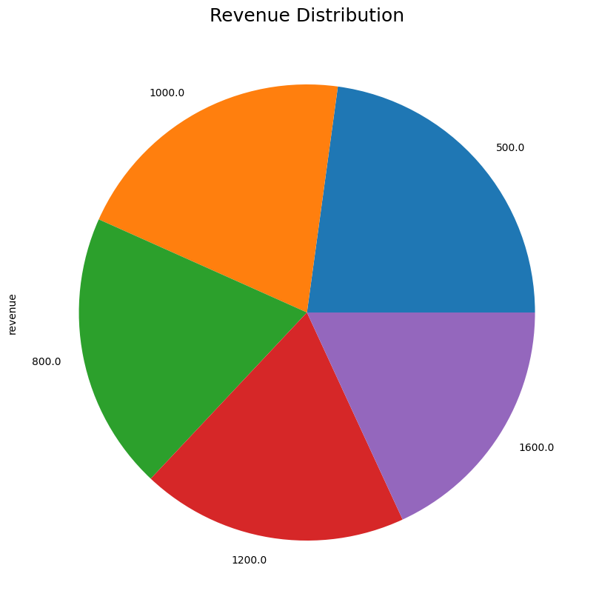
Question 1:
What was the total revenue generated by the company over the course of the year?
759130.0 USD

Slide 7
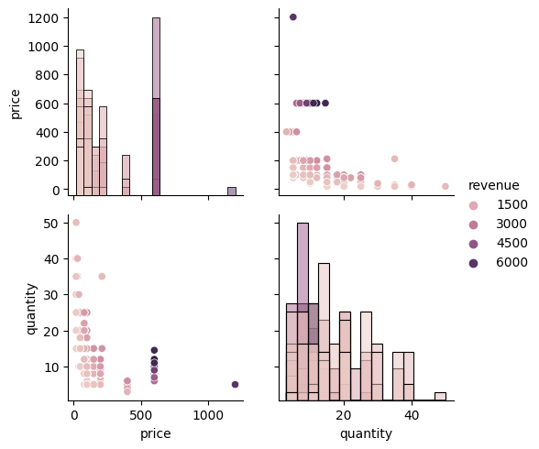
Question 1:

Slide 8
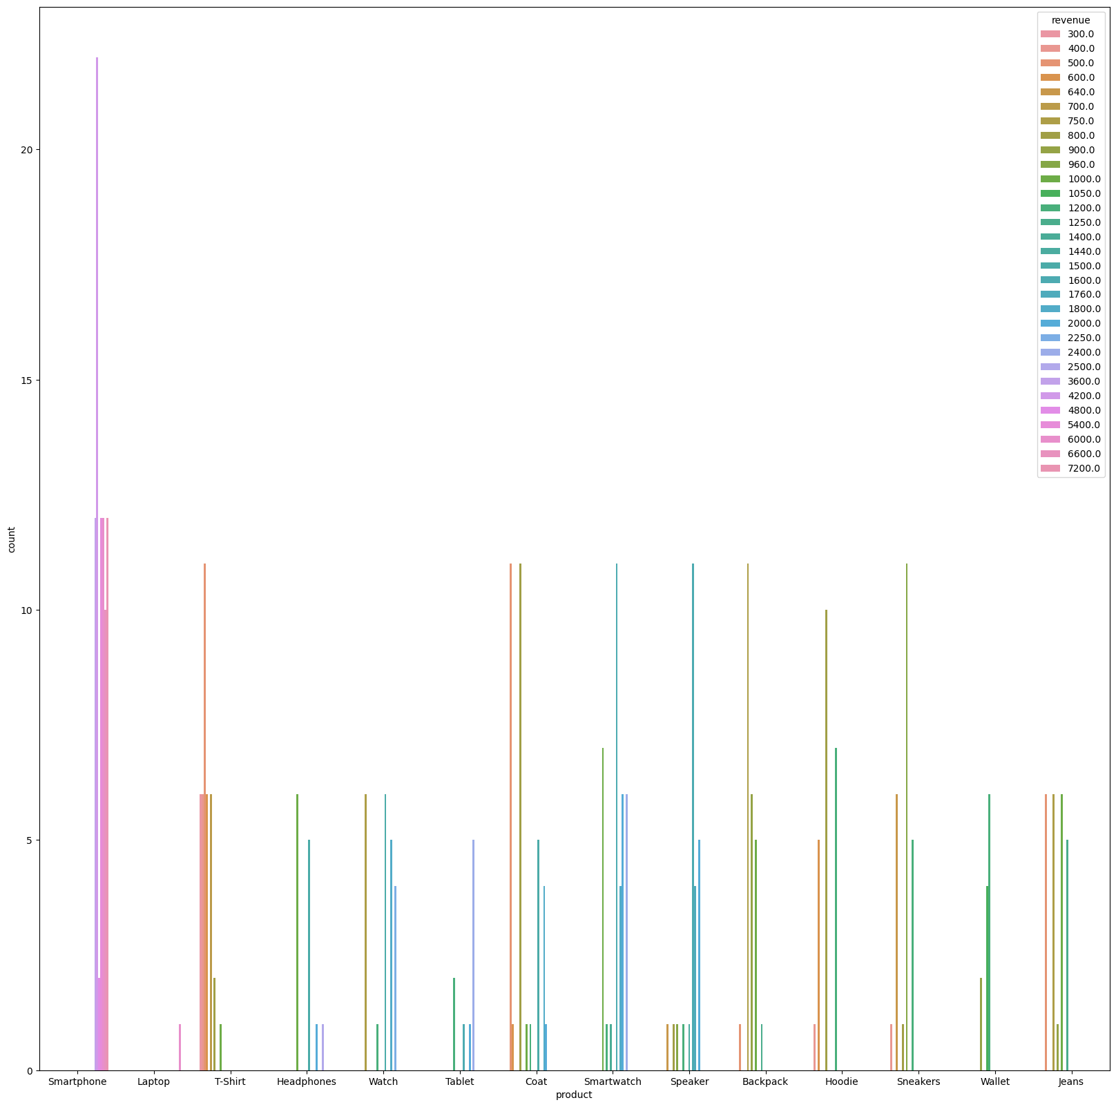
Question 2:
Which product had the highest revenue? How much revenue did it generate?
Smartphone product is highest revenue: 7200.0 USD
Total Generate: 759130.0 USD

Slide 9
Question 3:
Product | Average Price (Mean)
Smartphone | 600.0 USD
Laptop | 1200.0 USD
T-Shirt | 20.0 USD
Headphones | 100.0 USD
Watch | 152.804272 USD
Tablet | 400.0 USD
Coat | 100.0 USD
Smartwatch | 200.0 USD
Speaker | 80.0 USD
Backpack | 50.0 USD
Hoodie | 40.0 USD
Sneakers | 80.0 USD
Wallet | 45.141166 USD
Jeans | 50.0 USD
What was the average price of a product sold by the company?

Slide 10
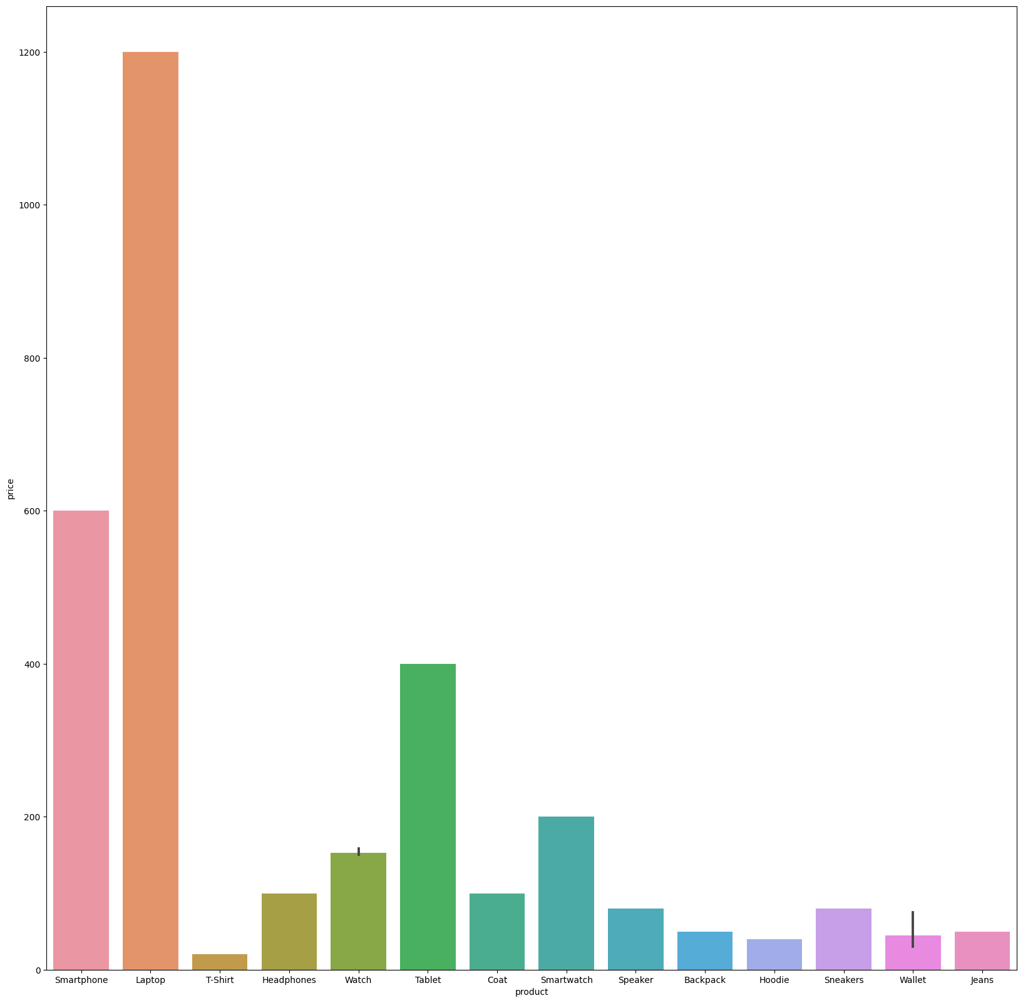
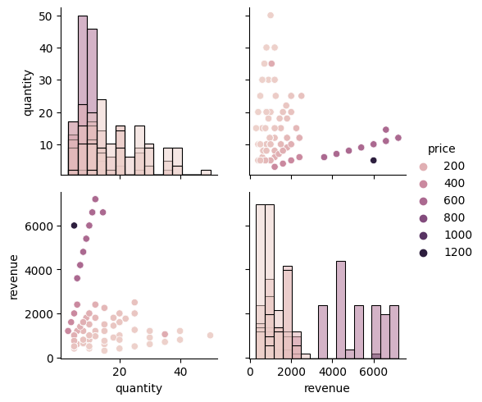
Question 3:

Slide 11
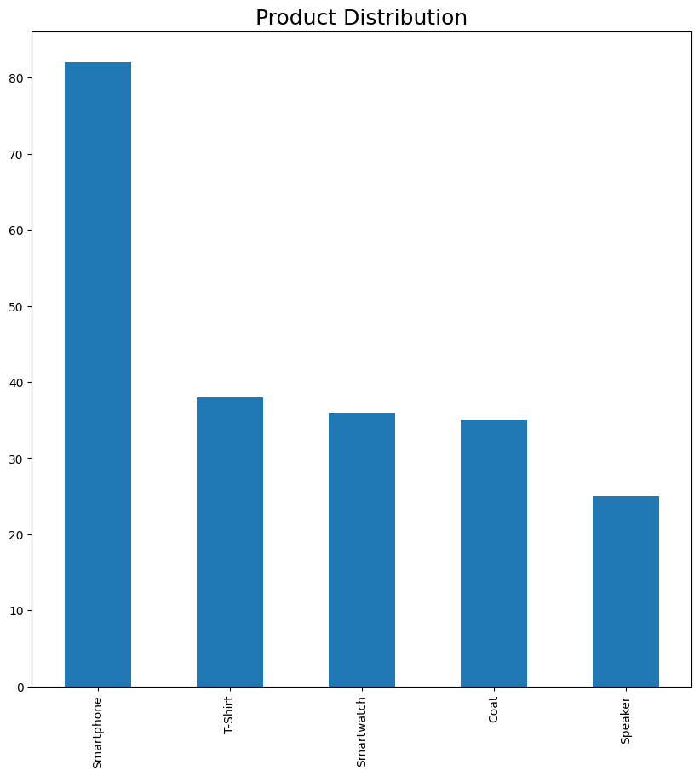
Question 4:
What was the total quantity of products sold by the company?
368 Product

Slide 12
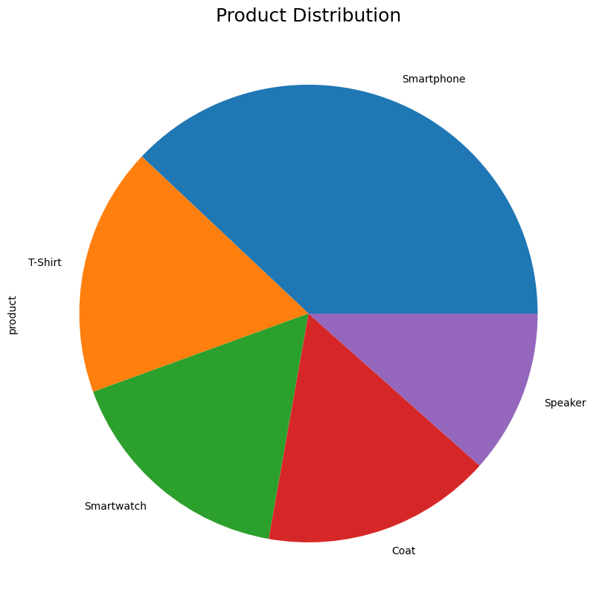
Question 4:

Slide 13
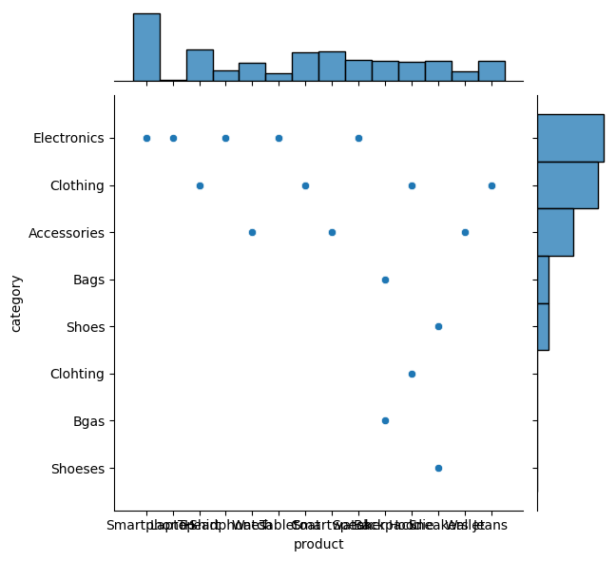
Question 4:

Slide 14
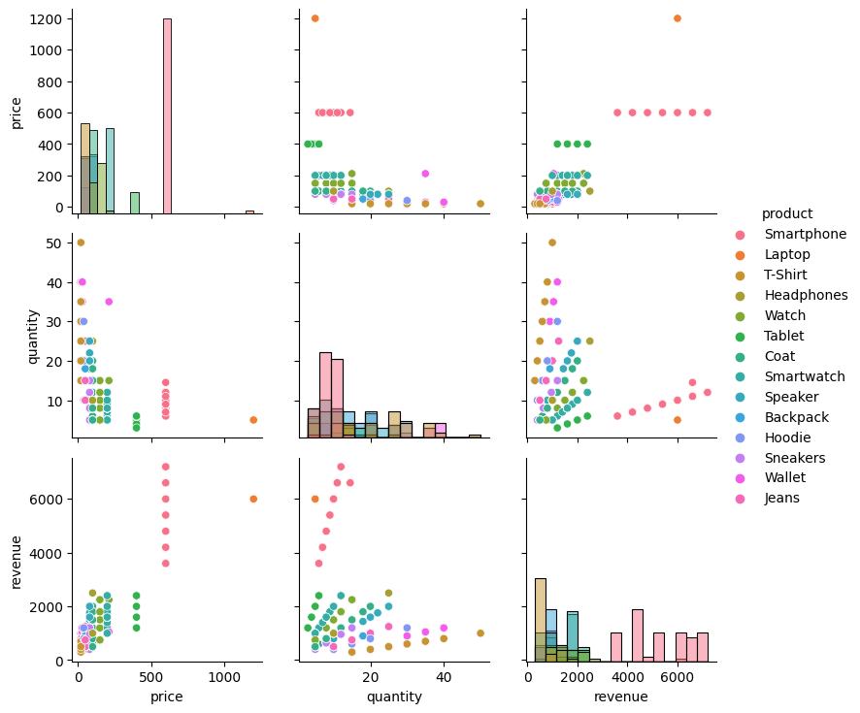
Question 4:

Slide 15
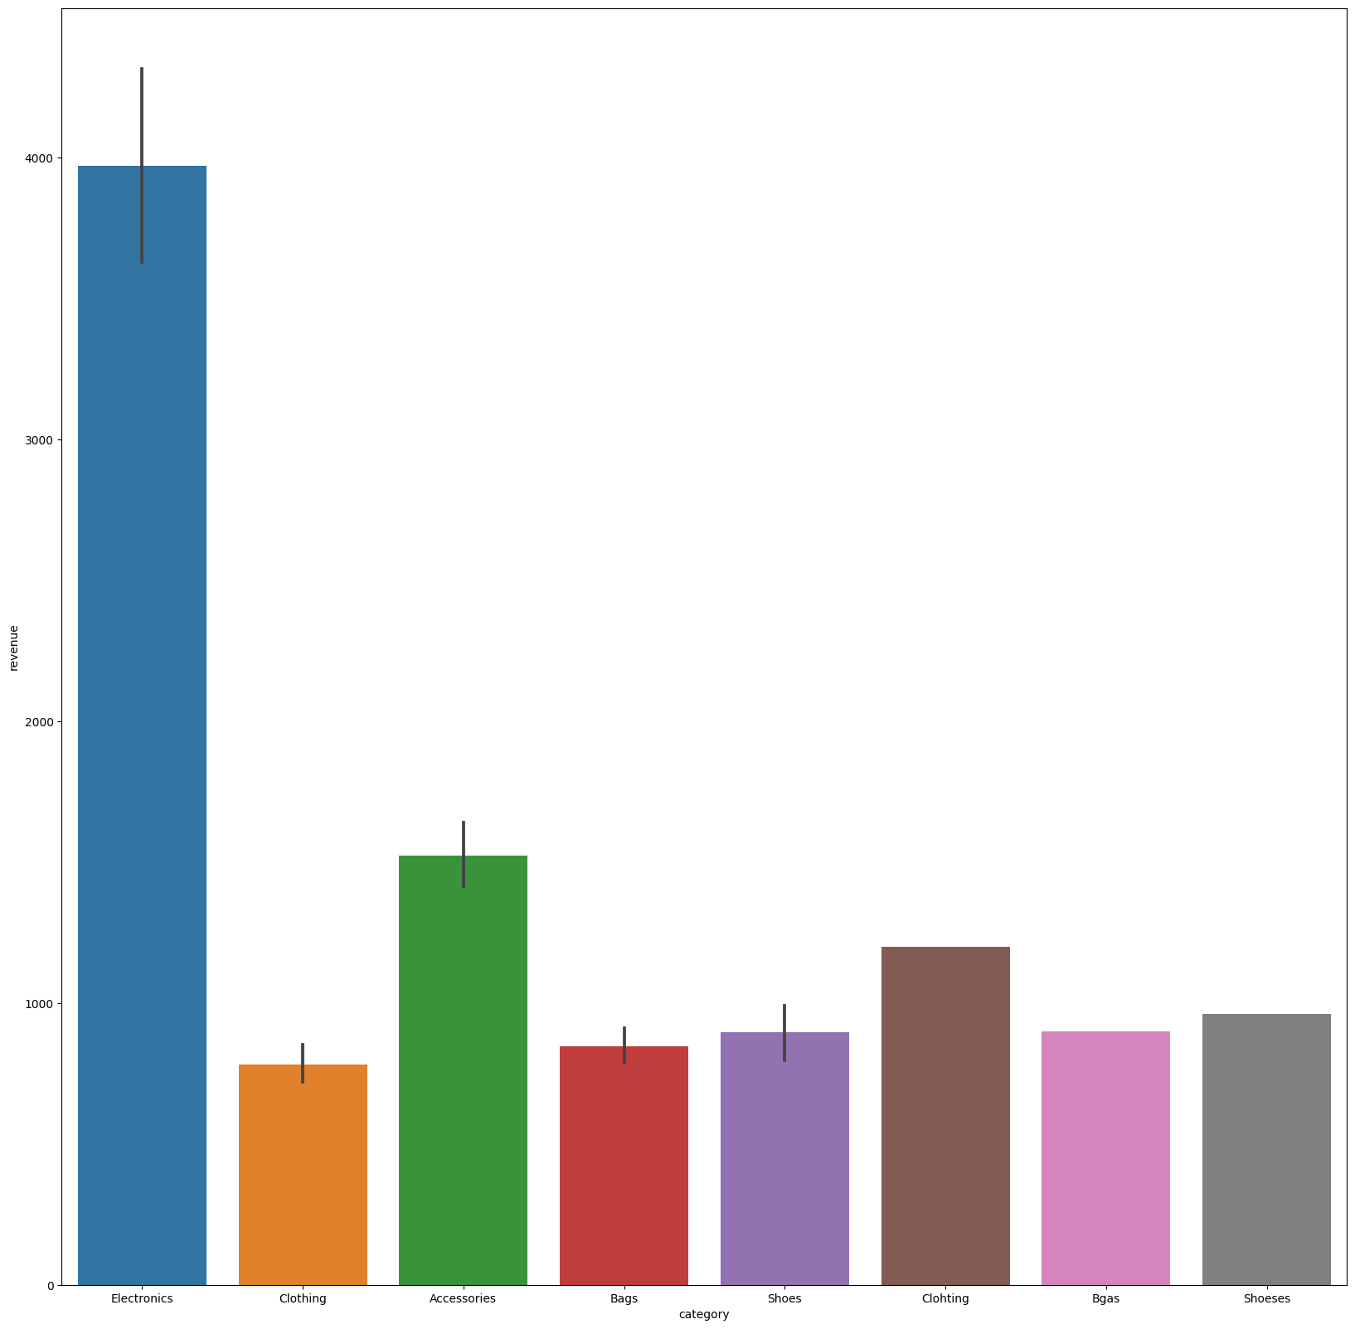
Question 5:
Which category had the highest revenue? How much revenue did it generate?
516080.0 USD

Slide 16
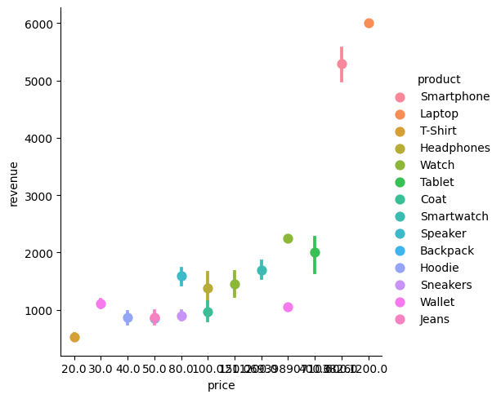
Question 6:
What was the average revenue per sale?
2062.85 USD / sale

Slide 17
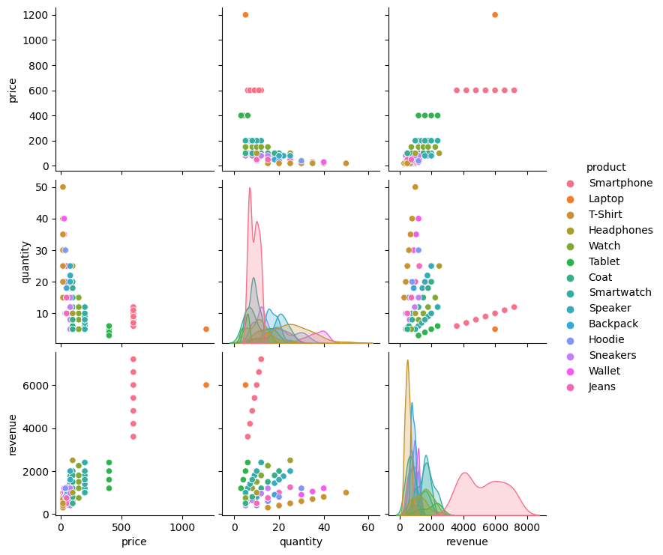
Question 6:

Slide 18
Question 7:
What was the total revenue generated in each quarter of the year?
Q | Total Revenue
Q1 (1, 2, 3) | 182100.0 USD
Q2 (4, 5 ,6) | 185970.0 USD
Q3 (7, 8 ,9) | 197680.0 USD
Q4 (10, 11, 12) | 193380.0 USD

